Slide 1
Sequences and Series
Algebra 2
Chapter 11

Slide 2
This Slideshow was developed to accompany the textbook
  Big Ideas Algebra 2
  By Larson, R., Boswell
  2022 K12 (National Geographic/Cengage)
Some examples and diagrams are taken from the textbook.
Slides created by
Richard Wright, Andrews Academy
rwright@andrews.edu

Slide 3
11.1A Defining and Using Sequences
After this lesson…
• I can use rules to write terms of sequences.
• I can write rules for sequences.

Slide 4
11.1A Defining and Using Sequences
Work with a partner.
a. For each pattern, find the number of objects in each figure. Then find the number of objects in the next figure. Explain your reasoning.

Slide 5

11.1A Defining and Using Sequences
Sequence
  Function whose domain are integers
  List of numbers that follow a rule
  2, 4, 6, 8, 10
    Finite
  2, 4, 6, 8, 10, …
    Infinite
Rule
  $a_{n}=2n$
Domain: (n)
  Term’s location (1st, 2nd, 3rd…)
Range: (a_{n})
  Term’s value (2, 4, 6, 8…)
Notes:
n is like x, a_{n} is like y

Slide 6


11.1A Defining and Using Sequences
Write the first four terms of
$a_{n}=\frac{1}{2}n−3$
Try 600#5
$f(n)=4^{n−1}$
Notes:
$$a_{1}=\frac{1}{2}\left(1\right)−3=−\frac{5}{2}$$
$$a_{2}=\frac{1}{2}\left(2\right)−3=−2$$
$$a_{3}=\frac{1}{2}\left(3\right)−3=−\frac{3}{2}$$
$$a_{4}=\frac{1}{2}\left(4\right)−3=−1$$
$$f\left(1\right)=4^{1−1}=4^{0}=1$$
$$f\left(2\right)=4^{2−1}=4^{1}=4$$
$$f\left(3\right)=4^{3−1}=4^{2}=16$$
$$f\left(4\right)=4^{4−1}=4^{3}=64$$

Slide 7
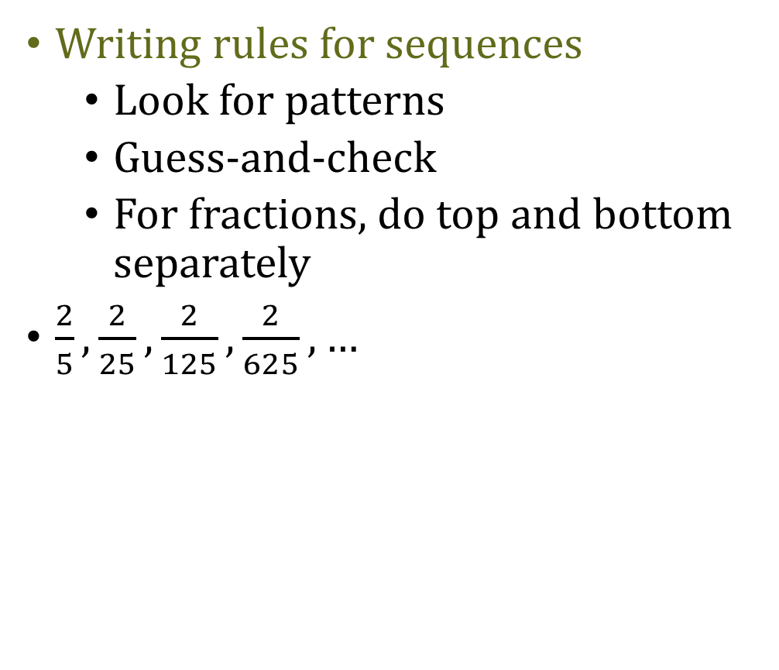
11.1A Defining and Using Sequences
Writing rules for sequences
  Look for patterns
  Guess-and-check
  For fractions, do top and bottom separately
$\frac{2}{5},\frac{2}{25},\frac{2}{125},\frac{2}{625},…$
Try 600#13
3.1, 3.8, 4.5, 5.2, …
Notes:
$$\frac{2}{5^{1}},\frac{2}{5^{2}},\frac{2}{5^{3}},\frac{2}{5^{4}}, … → a_{n}=\frac{2}{5^{n}}$$
$$3.1, 3.1+\left(1\right)0.7, 3.1+\left(2\right)0.7, 3.1+\left(3\right)0.7, … → a_{n}=3.1+\left(n−1\right)0.7=3.1+0.7n−0.7=0.7n+2.4$$

Slide 8
11.1A Defining and Using Sequences
To graph
  n is like x; a_{n} is like y
  The graph will be dots
    Do NOT connect the dots
Notes:
The n’s are integers so there is no values between the integers.

Slide 9
11.1B Defining and Using Series
After this lesson…
• I can write and find sums of series.

Slide 10
11.1B Defining and Using Series
Series
  Sum of a sequence
  2, 4, 6, 8, … → sequence
  2 + 4 + 6 + 8 + · · · → series

Slide 11

11.1B Defining and Using Series
Summation Notation (Sigma Notation)
  Finite
    $$2+4+6+8=\sum_{i=1}^{4}{2i}$$
  Infinite
    $$2+4+6+8+⋯=\sum_{i=1}^{∞}{2i}$$
Upper limit
Lower limit
Index of summation (variable)

Slide 12


11.1B Defining and Using Series
Write as a summation
  $4+8+12+⋯+100$
  Try 600#25
  $7+10+13+16+19$
Notes:
a_{n} = 4n, lower limit = 1, upper limit = 25
$$\sum_{n=1}^{25}{4n}$$
#25: a_{n} = 7 + (n − 1)3 = 3n + 4, lower limit = 1, upper limit = 5
$$\sum_{n=1}^{5}{\left(3n+4\right)}$$
Note that the index may be any letter.

Slide 13


11.1B Defining and Using Series
Find the sum of the series
$$\sum_{k=5}^{10}{k^{2}}+1$$
Try 600#39
$\sum_{i=2}^{8}{\frac{2}{i}}$
Notes:
5² + 1 + 6² + 1 + 7² + 1 + 8² +1 + 9² + 1 + 10² + 1 = 361
#39
$$\frac{2}{2}+\frac{2}{3}+\frac{2}{4}+\frac{2}{5}+\frac{2}{6}+\frac{2}{7}+\frac{2}{8}=\frac{481}{140}≈3.436$$

Slide 14

11.1B Defining and Using Series
Some shortcut formulas
$$\sum_{i=1}^{n}{1}=n$$
$$\sum_{i=1}^{n}{i}=\frac{n\left(n+1\right)}{2}$$
$$\sum_{i=1}^{n}{i^{2}}=\frac{n\left(n+1\right)\left(2n+1\right)}{6}$$

Slide 15


11.1B Defining and Using Series
Find the sum of the series
$$\sum_{k=1}^{10}{3k^{2}}+2$$
Try 600#43
$\sum_{i=10}^{25}{i}$
Notes:
$$3\frac{n\left(n+1\right)\left(2n+1\right)}{6}+2n=3\frac{10\left(10+1\right)\left(2\left(10\right)+1\right)}{6}+2\left(10\right)=1175$$
#43
$$\sum_{i=10}^{25}{i}=\sum_{i=1}^{25}{i}−\sum_{i=1}^{9}{i}$$
$$=\frac{n\left(n+1\right)}{2}−\frac{n\left(n+1\right)}{2}=\frac{25\left(25+1\right)}{2}−\frac{9\left(9+1\right)}{2}=325−45=280$$

Slide 16
11.2 Analyzing Arithmetic Sequences and Series
After this lesson…
• I can identify arithmetic sequences.
• I can write rules for arithmetic sequences.
• I can find sums of finite arithmetic series.

Slide 17

11.2 Analyzing Arithmetic Sequences and Series
Work with a partner. When German mathematician Carl Friedrich Gauss (1777–1855) was young, one of his teachers asked him to find the sum of the whole numbers from 1 through 100. To the astonishment of his teacher, Gauss came up with the answer after only a few moments. Here is what Gauss did:
$\begin{matrix}1 & + & 2 & + & 3 & +…+ & 100 \\ 100 & + & 99 & + & 98 & +…+ & 1 \\ 101 & + & 101 & + & 101 & +…+ & 101\end{matrix}$
$\frac{100×101}{2}=5050$
a. Explain Gauss’s thought process. Then write a formula for the sum S_{n} of the first n terms of an arithmetic sequence.
Notes:
$$S_{n}=\frac{n}{2}(a_{1}+a_{n})$$

Slide 18
11.2 Analyzing Arithmetic Sequences and Series
Arithmetic Sequences
  Common difference (d) between successive terms
    Add the same number each time
  3, 6, 9, 12, 15, …
    d = 3
Is it arithmetic?
  −10, −6, −2, 0, 2, 6, 10, …
  Try 608#1
  1, −1, −3, −5, −7, …
Notes:
No
Yes, d = −2

Slide 19

11.2 Analyzing Arithmetic Sequences and Series
Formula for n^{th} term
  $a_{n}=a_{1}+(n−1)d$
  Linear
Write a rule for the n^{th} term
  32, 47, 62, 77, …
Try 608#13
51, 48, 45, 42, …
Notes:
$$d=15$$
$$a_{n}=32+\left(n−1\right)15=32+15n−15 → a_{n}=17+15n$$
#13
$$d=−3, a_{1}=51$$
$$a_{n}=a_{1}+\left(n−1\right)d$$
$$a_{n}=51+\left(n−1\right)\left(−3\right)=51−3n+3→a_{n}=−3n+54$$

Slide 20

11.2 Analyzing Arithmetic Sequences and Series
One term of an arithmetic sequence is a₈ = 50. The common difference is 0.25. Write the rule for the n^{th} term.
Try 608#21
$a_{11}=43, d=5$
Notes:
$$a_{n}=a_{1}+(n−1)d$$
$$50=a_{1}+(8−1)0.25 → 50=a_{1}+1.75 → 48.25=a_{1}$$
$$a_{n}=48.25+\left(n−1\right)0.25 → a_{n}=48.25+0.25n−0.25 → a_{n}=48+0.25n$$
#21
$$a_{n}=a_{1}+\left(n−1\right)d$$
$$43=a_{1}+\left(11−1\right)5→43=a_{1}+50→−7=a_{1}$$
$$a_{n}=−7+\left(n−1\right)5→a_{n}=−7+5n−5→a_{n}=5n−12$$

Slide 21
11.2 Analyzing Arithmetic Sequences and Series
Two terms of an arithmetic sequence are a₅ = 10 and a₃₀ = 110. Write a rule for the n^{th} term.
Notes:
a_{n} = a₁ + (n – 1)d
10 = a₁ + (5 – 1)d → 10 = a₁ + 4d
110 = a₁ + (30 – 1)d → 110 = a₁ + 29d
Linear combination
-10 = -a₁ – 4d
110 = a₁ + 29d
100 = 25 d
d = 4
Substitute
= a₁ + 4d → 10 = a₁ + 4(4) → a₁ = -6
Rule
a_{n} = -6 +(n – 1)4 → a_{n} = -6 + 4n – 4 → a_{n} = 4n - 10

Slide 22
11.2 Analyzing Arithmetic Sequences and Series
Try 608#33
Two terms of an arithmetic sequence are a₈ = 12 and a₁₆ = 22. Write a rule for the n^{th} term.
Notes:
a_{n} = a₁ + (n – 1)d
12 = a₁ + (8 – 1)d → 12 = a₁ + 7d
22 = a₁ + (16 – 1)d → 22 = a₁ + 15d
Linear combination
-12 = -a₁ – 7d
22 = a₁ + 15d
10 = 8 d
d = 5/4
Substitute
12 = a₁ + 7d → 12 = a₁ + 7(5/4) → 12 = a₁ + 35/4 → a₁ = 13/4
Rule
a_{n} = 13/4 +(n – 1)5/4 → a_{n} = 13/4 + 5n/4 – 5/4 → a_{n} = (5/4)n + 2

Slide 23

11.2 Analyzing Arithmetic Sequences and Series
Sum of a finite arithmetic series
  1 + 2 + 3 + 4 + 5 + 6 + 7 + 8 + 9 + 10
  Rewrite
    1 + 2 + 3 + 4 + 5
    10 + 9 + 8 + 7 + 6
    11+11 +11+11 +11 = 5(11) = 55
  Formula
    $S_{n}=n\left(\frac{a_{1}+a_{n}}{2}\right)$
Notes:
From example:
First and last (a₁ + a_{n}) = 11
10 numbers but only half as many pairs (n/2)

Slide 24

11.2 Analyzing Arithmetic Sequences and Series
Consider the arithmetic series
  20 + 18 + 16 + 14 + ···
Find the sum of the first 25 terms.
Try 609#41
$\sum_{i=1}^{20}{\left(2i−3\right)}$
Notes:
$$a_{25}=20+(25−1)(−2)=−28$$
$$S_{25}=25\left(\frac{20+\left(−28\right)}{2}\right)=−100$$
#41: This is arithmetic because the rule is linear
$$S_{n}=n\left(\frac{a_{1}+a_{n}}{2}\right)$$
$$S_{20}=20 \left(\frac{\left(2\left(1\right)−3\right)+\left(2\left(20\right)−3\right)}{2}\right)=20\left(18\right)=360$$

Slide 25
11.2 Analyzing Arithmetic Sequences and Series
You put money in a jar at the end of each week. The first week you put $2 in the jar, and each subsequent week you put $2 more than the previous week in the jar.
a. Write a rule for the amount of money you put in the jar at the end of the nth week.
b. How much money is in the jar after 9 weeks?
Notes:
2, 4, 6, 8, …
a_{n} = 2n
$S_{n}=\frac{n\left(a_{1}+a_{n}\right)}{2}=\frac{9\left(2+18\right)}{2}=$$90

Slide 26
11.3 Analyzing Geometric Sequences and Series
After this lesson…
• I can identify geometric sequences.
• I can write rules for geometric sequences.
• I can find sums of finite geometric series.

Slide 27
11.3 Analyzing Geometric Sequences and Series
Geometric Sequence
  Created by multiplying by a common ratio (r)
Are these geometric sequences?
  1, 2, 6, 24, 120, …
  Try 616#1
  96, 48, 24, 12, 6, …
Notes:
No
Yes r = 1/2

Slide 28
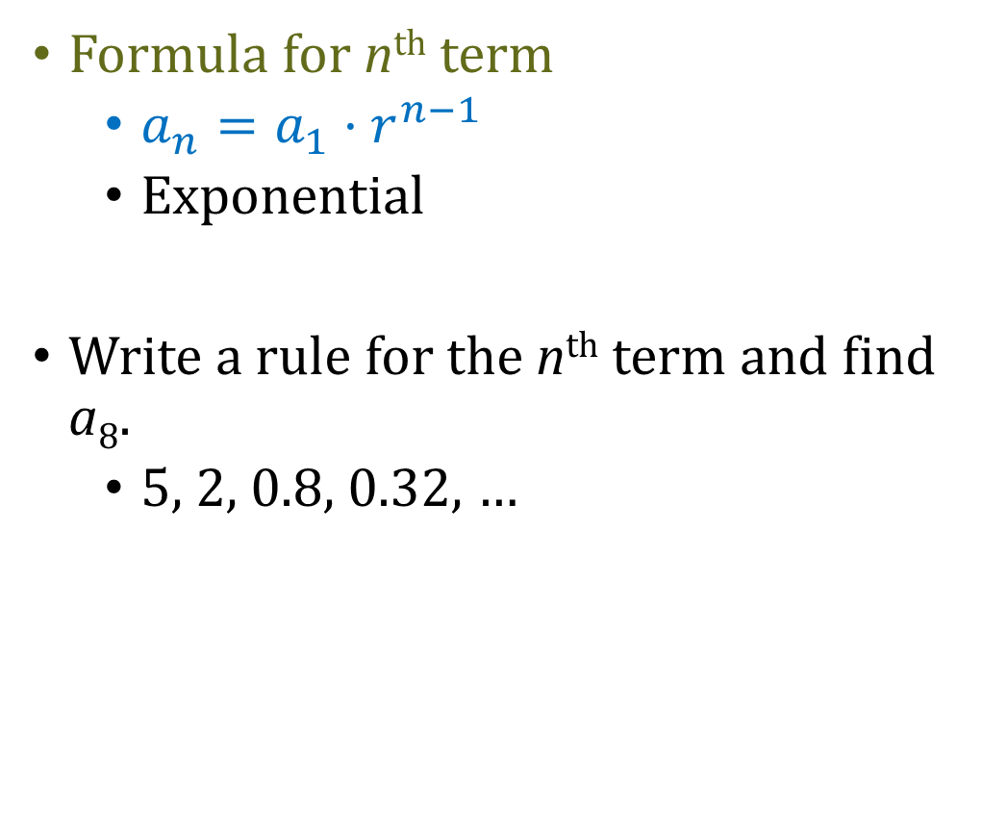
11.3 Analyzing Geometric Sequences and Series
Formula for n^{th} term
  $a_{n}=a_{1}·r^{n−1}$
  Exponential
Write a rule for the n^{th} term and find a₈.
  5, 2, 0.8, 0.32, …
Try 616#13
112, 56, 28, 14, …
Notes:
$$r=\frac{2}{5}$$
$$a_{n}=5{\left(\frac{2}{5}\right)}^{n−1}$$
$$a_8=5{\left(\frac{2}{5}\right)}^{7}=0.008192$$
#13
$$a_{1}=112;r=\frac{1}{2}$$
$$a_{n}=a_{1}r^{n−1}$$
$$a_{n}=112{\left(\frac{1}{2}\right)}^{n−1}$$

Slide 29
11.3 Analyzing Geometric Sequences and Series
One term of a geometric sequence is a₄ = 3 and r = 3. Write the rule for the n^{th} term.
Try 616#23
One term of a geometric sequence is a₄ = −192 and r = 4. Write the rule for the n^{th} term.
Notes:
$$a_{4}=3=a_{1}3^{4−1} → 3=a_{1} 27 → a_{1}=\frac{1}{9}$$
$$a_{n}=\left(\frac{1}{9}\right)3^{n−1}$$
#23
$$a_{n}=a_{1}r^{n−1}$$
$$−192=a_{1}{\left(4\right)}^{4−1}→−192=a_{1}\left(64\right)→ a_{1}=−3$$
$$a_{n}=−3{\left(4\right)}^{n−1}$$

Slide 30
11.3 Analyzing Geometric Sequences and Series
If two terms of a geometric sequence are a₂ = −4 and a₆ = −1024, write rule for the n^{th} term.
Notes:
$$a_{2}=−4=a_{1} r^{2−1} → −4=a_{1} r$$
$$a_{6}=−1024=a_{1} r^{6−1} → −1024=a_{1} r^{5}$$
Solve first for a₁: $a_{1}=−\frac{4}{r}$
Plug into second: $−1024=\left(−\frac{4}{r}\right)r^{5} → −1024=−\frac{4r^{5}}{r} → −1024=−4r^{4} → 256=r^{4} → r=4$
Plug back into first: $a_{1}=−\frac{4}{4} → a_{1}=−1$
Write rule: $a_{n}=−1·4^{n−1}$

Slide 31

11.3 Analyzing Geometric Sequences and Series
Try 616#35
If two terms of a geometric sequence are a₂ = −72 and a₆ = $−\frac{1}{18}$, write rule for the n^{th} term.
Notes:
$$a_{2}=−72=a_{1} r^{2−1} → −72=a_{1} r$$
$$a_{6}=−\frac{1}{18}=a_{1} r^{6−1} → −\frac{1}{18}=a_{1} r^{5}$$
Solve first for a₁: $a_{1}=−\frac{72}{r}$
Plug into second: $−\frac{1}{18}=\left(−\frac{72}{r}\right)r^{5} → −\frac{1}{18}=−\frac{72r^{5}}{r} → −\frac{1}{18}=−72r^{4} →\frac{1}{1296}=r^{4} → r=\frac{1}{6}$
Plug back into first: $a_{1}=−\frac{72}{1/6} → a_{1}=−432$
Write rule: $a_{n}=−432·{\left(\frac{1}{6}\right)}^{n−1}$

Slide 32


11.3 Analyzing Geometric Sequences and Series
Sum of geometric series
  $S_{n}=a_{1}\left(\frac{1−r^{n}}{1−r}\right)$
Find the sum of the first 10 terms of
  4 + 2 + 1 + ½ + ···
Try 617#44
$\sum_{i=1}^{8}{5{\left(\frac{1}{3}\right)}^{i−1}}$
Notes:
$$r=\frac{1}{2}, a_{1}=4$$
$$S_{10}=4\left(\frac{1−{\left(\frac{1}{2}\right)}^{10}}{1−\frac{1}{2}}\right)=4\left(\frac{.99902}{.5}\right)=7.992=\frac{1023}{128}$$
#44: geometric because exponential
$$a_{n}=a_{1}r^{n−1}$$
$$a_{1}=5, r=\frac{1}{3}$$
$$S_{8}=a_{1}\left(\frac{1−r^{n}}{1−r}\right)=5\left(\frac{1−{\left(\frac{1}{3}\right)}^{8}}{1−\frac{1}{3}}\right)=\frac{16400}{2187}≈7.499$$

Slide 33
11.3 Analyzing Geometric Sequences and Series
You tell the Gospel to your friends. Four of your friends tell the Gospel to their friends, then four of each of their friends tells the Gospel, and so on. Find the total number of people who told the Gospel to others after the eighth round.
Notes:
$$r=4, a_{1}=4$$
$$S_{n}=a_{1}\left(\frac{1−r^{n}}{1−r}\right)$$
$$S_{8}=4\left(\frac{1−4^{8}}{1−4}\right)=87380 people$$

Slide 34
11.4 Finding Sums of Infinite Geometric Series
After this lesson…
• I can find partial sums of infinite geometric series.
• I can find sums of infinite geometric series.
• I can solve real-life problems using infinite geometric series.

Slide 35
11.4 Finding Sums of Infinite Geometric Series

Slide 36

11.4 Finding Sums of Infinite Geometric Series
$$\frac{1}{2}=0.5$$

Slide 37

11.4 Finding Sums of Infinite Geometric Series
$$\frac{1}{2}=0.5$$
$$\frac{1}{2}+\frac{1}{4}=0.75$$

Slide 38

11.4 Finding Sums of Infinite Geometric Series
$$\frac{1}{2}=0.5$$
$$\frac{1}{2}+\frac{1}{4}=0.75$$
$$\frac{1}{2}+\frac{1}{4}+\frac{1}{8}=0.875$$

Slide 39

11.4 Finding Sums of Infinite Geometric Series
$$\frac{1}{2}=0.5$$
$$\frac{1}{2}+\frac{1}{4}=0.75$$
$$\frac{1}{2}+\frac{1}{4}+\frac{1}{8}=0.875$$
$$\frac{1}{2}+\frac{1}{4}+\frac{1}{8}+\frac{1}{16}=0.9375$$

Slide 40

11.4 Finding Sums of Infinite Geometric Series
$$\frac{1}{2}=0.5$$
$$\frac{1}{2}+\frac{1}{4}=0.75$$
$$\frac{1}{2}+\frac{1}{4}+\frac{1}{8}=0.875$$
$$\frac{1}{2}+\frac{1}{4}+\frac{1}{8}+\frac{1}{16}=0.9375$$
$$\frac{1}{2}+\frac{1}{4}+\frac{1}{8}+\frac{1}{16}+\frac{1}{32}=0.96875$$

Slide 41

11.4 Finding Sums of Infinite Geometric Series
$$\frac{1}{2}=0.5$$
$$\frac{1}{2}+\frac{1}{4}=0.75$$
$$\frac{1}{2}+\frac{1}{4}+\frac{1}{8}=0.875$$
$$\frac{1}{2}+\frac{1}{4}+\frac{1}{8}+\frac{1}{16}=0.9375$$
$$\frac{1}{2}+\frac{1}{4}+\frac{1}{8}+\frac{1}{16}+\frac{1}{32}=0.96875$$
$$\frac{1}{2}+\frac{1}{4}+\frac{1}{8}+\frac{1}{16}+\frac{1}{32}+\frac{1}{64}=0.984375$$
What happens if the pattern continues forever?
Notes:
Eventually the entire square is filled in

Slide 42


Find the partial sums for n = 1, 2, 3, 4, 5 and describe what happens to S_{n} as n increases.
$\frac{1}{5}+\frac{1}{10}+\frac{1}{20}+\frac{1}{40}+\frac{1}{80}+…$
Try 623#3
$4+\frac{12}{5}+\frac{36}{25}+\frac{108}{125}+\frac{324}{625}+…$
Notes:
$$S_{1}=\frac{1}{5}=0.2$$
$$S_{2}=\frac{1}{5}+\frac{1}{10}=\frac{3}{10}=0.3$$
$$S_{3}=\frac{1}{5}+\frac{1}{10}+\frac{1}{20}=\frac{7}{20}=0.35$$
$$S_{4}=\frac{1}{5}+\frac{1}{10}+\frac{1}{20}+\frac{1}{40}=\frac{15}{40}=0.375$$
$$S_{5}=\frac{1}{5}+\frac{1}{10}+\frac{1}{20}+\frac{1}{40}+\frac{1}{80}=\frac{31}{80}=0.3875$$
Approaching 4
#3
$$S_{1}=4$$
$$S_{2}=4+\frac{12}{5}=\frac{32}{5}=6.4$$
$$S_{3}=4+\frac{12}{5}+\frac{36}{25}=\frac{196}{25}=7.84$$
$$S_{4}=4+\frac{12}{5}+\frac{36}{25}+\frac{108}{125}=\frac{1088}{125}=8.704$$
$$S_{5}=4+\frac{12}{5}+\frac{36}{25}+\frac{108}{125}+\frac{324}{625}=\frac{5764}{625}=9.2224$$
Approaches 10

Slide 43

11.4 Finding Sums of Infinite Geometric Series
Sum of an infinite geometric series
  $S=\frac{a_{1}}{1−r}$
| r | < 1
  If | r | > 1, then no sum (∞)

Slide 44


11.4 Finding Sums of Infinite Geometric Series
Find the sum
$$\sum_{i=1}^{∞}{2{\left(0.1\right)}^{i−1}}$$
Try 623#9
$2+\frac{6}{4}+\frac{18}{16}+\frac{54}{64}+…$
Notes:
$$a_{1}=2{\left(0.1\right)}^{1−1}=2, r=0.1$$
$$S=\frac{2}{1−0.1}=\frac{2}{0.9}=\frac{20}{9}$$
#9
$$a_{1}=2, r=\frac{3}{4}$$
$$S=\frac{2}{1−\frac{3}{4}}=\frac{2}{\frac{1}{4}}=8$$

Slide 45
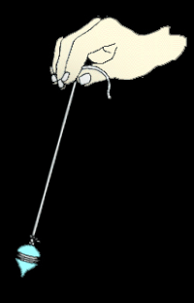
11.4 Finding Sums of Infinite Geometric Series
A pendulum that is released and swings freely travels 100 centimeters on the first swing. On each successive swing, the pendulum travels 96% of the distance of the previous swing. What is the total distance the pendulum travels?
Notes:
$$a_{1}=100, r=0.96$$
$$S_{∞}=\frac{a_{1}}{1−r}$$
$$S_{∞}=\frac{100}{1−0.96}=2500 cm=25 m$$

Slide 46
11.4 Finding Sums of Infinite Geometric Series
Write 0.27272727… as a fraction.
Notes:
Write the repeating unit as a sum of fractions
$$\frac{27}{100}+\frac{27}{10000}+\frac{27}{1000000}+ …$$
$$a_{1}=\frac{27}{100}, r=\frac{1}{100}$$
$$S=\frac{\frac{27}{100}}{1−\left(\frac{1}{100}\right)}=\frac{\frac{27}{100}}{\frac{99}{100}}=\frac{27}{99}=\frac{3}{11}$$

Slide 47
11.4 Finding Sums of Infinite Geometric Series
Try 623#21
Write 32.323232… as a fraction.
Notes:
#21
$$32+\frac{32}{100}+\frac{32}{10000}+\frac{32}{1000000}+…$$
$$a_{1}=32, r=\frac{1}{100}$$
$$S_{∞}=\frac{a_{1}}{1−r}=\frac{32}{1−\frac{1}{100}}$$
$$=\frac{32}{99/100}$$
$$=\frac{3200}{99}$$

Slide 48
11.5 Using Recursive Rules with Sequences
After this lesson…
• I can write terms of recursively defi ned sequences.
• I can write recursive rules for sequences.
• I can translate between recursive rules and explicit rules.
• I can use recursive rules to solve real-life problems.

Slide 49
11.5 Using Recursive Rules with Sequences
Explicit Rule
  Gives the n^{th} term directly
  a_{n} = 2 + 4n
Recursive Rule
  Each term is found by knowing the previous term
  a₁ = 6; a_{n} = a_{n−1} + 4
Notes:
Both these rules give the same sequence

Slide 50


11.5 Using Recursive Rules with Sequences
Write the first 5 terms
  $a_{1}=3, a_{n}=2a_{n−1}−1$
  Try 631#5
  $a_{1}=2;a_{n}={\left(a_{n−1}\right)}^{2}+1$
Notes:
$$a_{1}=3,$$
$$a_{2}=2\left(3\right)−1=5,$$
$$a_{3}=2\left(5\right)−1=9,$$
$$a_{4}=2\left(9\right)−1=17,$$
$$a_{5}=2\left(17\right)−1=33$$
#5
$$a_{1}=2,$$
$$a_{2}={\left(2\right)}^{2}+1=5,$$
$$a_{3}={\left(5\right)}^{2}+1=26,$$
$$a_{4}={\left(26\right)}^{2}+1=677,$$
$$a_{5}={\left(677\right)}^{2}+1=458330$$

Slide 51

11.5 Using Recursive Rules with Sequences
Special Recursive Rules
  Arithmetic Sequence
    $a_{n}=a_{n−1}+d, a_{1}=a_{1}$
  Geometric Sequence
    $a_{n}=r·a_{n−1}, a_{1}=a_{1}$

Slide 52
11.5 Using Recursive Rules with Sequences
Write the rules for the arithmetic sequence where a₁ = 15 and d = 5.
  Explicit
  Recursive
Notes:
Explicit: $a_{n}=15+(n−1)5 → a_{n}=5n+10$
Recursive: $a_{1}=15, a_{n}=a_{n−1}+5$

Slide 53
11.5 Using Recursive Rules with Sequences
Write the rule for the geometric sequence where a₁ = 4 and r = 0.2
  Explicit
  Recursive
Notes:
Explicit: $a_{n}=4{\left(0.2\right)}^{n−1}$
Recursive: $a_{1}=4, a_{n}=0.2a_{n−1}$

Slide 54

11.5 Using Recursive Rules with Sequences
Write a recursive rule for
  1, 1, 4, 10, 28, 76, …
  Try 631#13
  $44, 11,\frac{11}{4},\frac{11}{16},\frac{11}{64},…$
Notes:
$$a_{1}=1, a_{2}=1, a_{n}=2(a_{n−2}+a_{n−1})$$
#13: geometric, multiplying by 1/4
$$a_{1}=1, a_{n}=\frac{1}{4}a_{n−1}$$

Slide 55


11.5 Using Recursive Rules with Sequences
Write a recursive rule for
$a_{n}=30−5n$
Try 631#29
$a_{n}=12{\left(11\right)}^{n−1}$
Notes:
This is arithmetic in the form where d = −5 and $a_{1}=30−5\left(1\right)=25$
$$a_{n}=a_{n−1}+d$$
$$a_{n}=a_{n−1}−5, a_{1}=25$$
This is geometric with $a_{n}=a_{1}·r^{n−1}$ where r = 11 and $a_{1}=12$
$$a_{n}=r·a_{n−1}$$
$$a_{n}=11·a_{n−1},a_{1}=12$$

Slide 56


11.5 Using Recursive Rules with Sequences
Write an explicit rule for each sequence.
$a_{1}=7, a_{n}=a_{n−1}+4$
Try 631#39
$a_{1}=−2; a_{n}=3a_{n−1}$
Notes:
This is arithmetic because it is adding with form $a_{n}=a_{n−1}+d$. d = 4
$$a_{n}=a_{1}+\left(n−1\right)d$$
$$a_{n}=7+\left(n−1\right)4$$
$$a_{n}=7+4n−4$$
$$a_{n}=4n+3$$
This is geometric because it is multiplying from $a_{n}=r·a_{n−1}$. r = 3
$$a_{n}=a_{1}·r^{n−1}$$
$$a_{n}=−2{\left(3\right)}^{n−1}$$

Slide 57
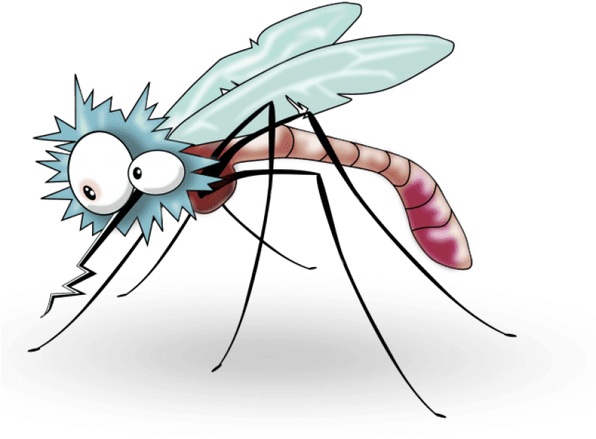
11.5 Using Recursive Rules with Sequences
A controlled laboratory contains about 500 mosquitoes. Each day, 100 new mosquitoes hatch, but the population declines 85% due to a pesticide and natural causes.
a. Write a recursive rule for the number a_{n} of mosquitoes at the start of the n^{th} day.
b. Find the number of mosquitoes at the start of the fourth day.
c. Describe what happens to the population of mosquitoes over time.
Notes:
If lose 85%, then still have 15%
$$a_{1}=500, a_{n}=0.15a_{n−1}+100$$
$$a_{1}=500$$
$$a_{2}=0.15\left(500\right)+100=175$$
$$a_{3}=0.15\left(175\right)+100=126.25$$
$$a_{4}=0.15\left(126.25\right)+100=118.9375$$
about 119 mosquitoes
Find lots of points by using calculator with .15·ans+100
Approaches 118 mosquitoes

Slide 58
11.5 Using Recursive Rules with Sequences
Try 632#53
You borrow $2000 to travel. The loan has a 9% annual interest rate that is compounded monthly for 2 years. The monthly payment is $91.37.
Find the balance after the fifth payment.
Find the amount of the last payment.
Notes:
Monthly interest rate is 0.09/12=0.0075
$a_{0}=2000; a_{n}=a_{n−1}+0.0075a_{n−1}−91.37=1.0075a_{n−1}−91.37$
$a_{1}=1.0075\left(2000\right)−91.37=1923.63$
$a_{2}=1.0075\left(1923.63\right)−91.37=1846.69$
$a_{3}=1.0075\left(1846.69\right)−91.37=1769.17$
$a_{4}=1.0075\left(1769.17\right)−91.37=1691.07$
$a_{5}=1.0075\left(1691.07\right)−91.37=1612.38$
Use a calculator and enter 1.0075(2000)-91.37 and press enter. Then enter 1.0075(ans)-91.37 and press enter repeatedly until reaching 0.
$90.68

